Slide 1
Using (LiFepo4) Lithium Iron Phosphate Batteries in Aviation
Engine Starting Batteries

Slide 2
Destructive Testing

Slide 3
Why is LiFePo4 safe ?

Slide 7
Impedance Values .. 19 mohms

Slide 8
10.5mohms

Slide 9
Low Impedance .. 10.8 mohms

Slide 10
SLA discharge curve low C-rate

Slide 12
Lithium discharge curves, hi C rate

Slide 13
Energy Densities

Slide 14
Watthours / kg – Watthrs / Liter

Slide 15
Rogone plot - energy storage

Slide 16
Energy Release / chemistry

Slide 17
Lithium cells

Slide 18
Lithium can safety valve

Slide 19
See-thru clear case design

Slide 21
BMS

Slide 22
Balancing circuit

Slide 23
Balancing charger

Slide 24
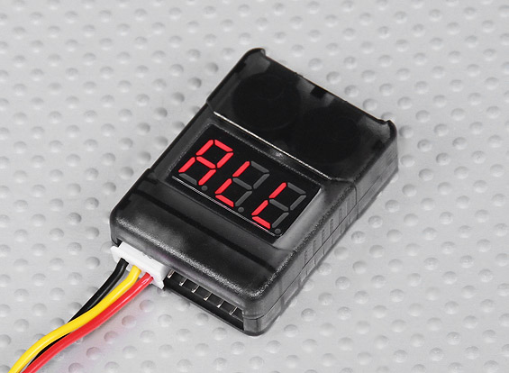
Low V alarm , LVC circuit

Slide 25
ADVANTAGES
Much less weight
Smaller size
Flatter discharge curve
Very low self discharge rate
Very long cycle life
Deep cycle ability
No maintenance needed
Cheaper than lead acid in the long run
Environmentally friendly

Slide 27
TOO FAST

Slide 29
REFERENCES
Dynalab Wikipedia
A123 MIT
Battery university Goodenough UT
Electropedia Aleees
Phostech Ti Sandia Labs

